Slide 1
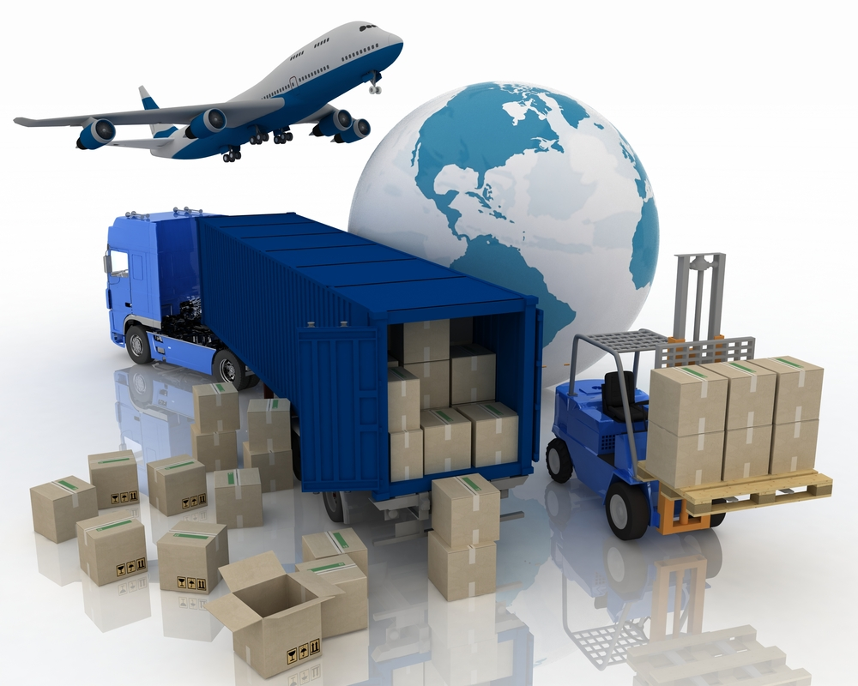
Supply Chain Management using IoT(internet of Things)
Author : Pratik singh
NUID : 001625041

Slide 2
What is SCM ?
Network of business linked together
Coordinate functions and strategies to improve performance
Includes several other branches
IoT improves various management processes
SCM is a cyclic process

Slide 3
Problem Statement
Warehouse :
Manual labor can lead to high error rate
Delay in requests processing may affect business
Track efforts of the employes

Slide 4
Problem Statement contd..
Transport and Supplier:
Less visibility to the customer
Business may incur loss due to delay in freight loading process
Inefficient processing of the warehouse requests
puts the SCM process in Stand still position

Slide 5
Problem Statement contd..
Freight Management:
Identification of the loading capacity of each trailer
Availability of the trailer for sending goods across
Condition of the Trailer
Location of the freight

Slide 6
Problem Statement contd..
Data Analytics:
How to find whether the PUC is required for trucks
How to find the best employer in warehouse Department based on the number of requests processed ?
How to analyze the data over time ?

Slide 7
Proposed Solution
Warehouse Management:
IoT eliminates manual intervention
Alert triggered when data below threshold
Transport Management & Supplier :
Implementation provides new level of visibility and connectivity.
Requests processed in sequential manner
Freight Management:
Sensors implemented to get the condition of the trailer (Simulated)
Location sensor provide the current freight location (Simulated)

Slide 8
Problem Solution contd..
Data analytics:
Graphs incorporated to provide better analytics
Sensor on freight provides whether PUC is required or not
Top employer calculated to increase productivity
Freight parameters can be monitored

Slide 9
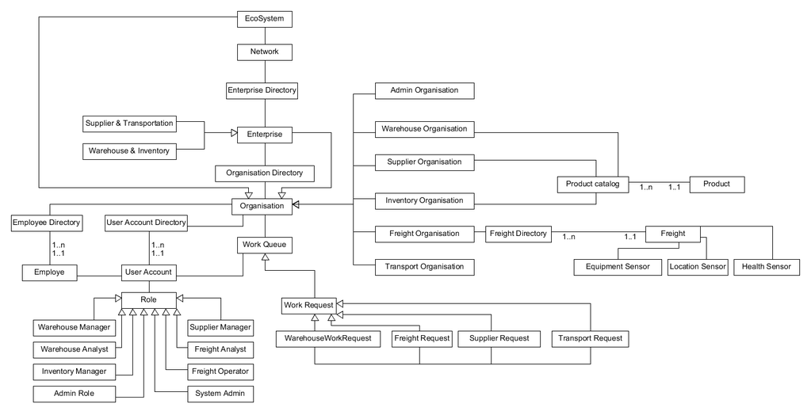
Object Model Diagram

Slide 10
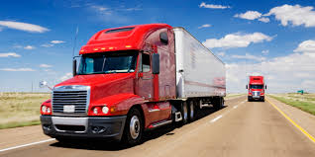
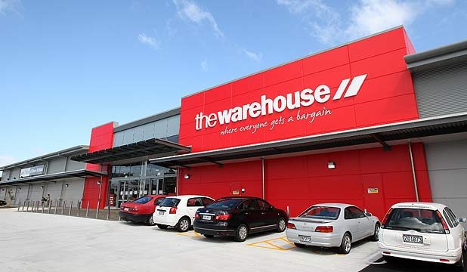
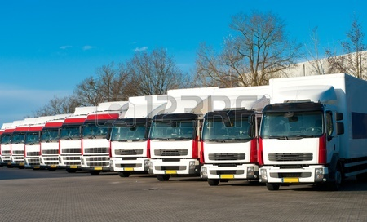

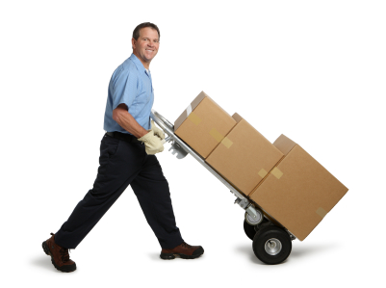
Basic Workflow Diagram
Inventory
5
4
Warehouse
Transport
1
3
Supplier
Inventory
2

Slide 11
Roles and Responsibilities:
Warehouse Manager:
Place request to supplier
Track order status
Manage warehouse goods
Check freight status
Change the destination address once freight has left
Supplier
Manage products
Process requests from warehouse
Forward request to transportation department
Add new product

Slide 12
Roles and Responsibilities contd..
Transport Manager:
Process request from the supplier
Place request for freights
View freight policies
Freight Operator :
Process request from transport
Load trailer as per availability
Dispatch parcel to warehouse
Check status for delivery
Process requests for Re routing

Slide 13
Roles and Responsibilities contd..
Inventory Manager :
Manage Inventory Products
Fetch product from the Warehouse
Admin :
Manage organization
Manage Employees
Manage user accounts

Slide 14
Roles & Responsibilities
Freight data analyst:
Track the location of freight
Check the freight conditions
Analyze the freight tire pressures
Analyze the overall health
Find the top three ecofriendly freight
Warehouse data analyst:
Find the best warehouse employer based on number of requests
Products
Analyze the warehouse product over time

Slide 15
Key Features
Identify the Freight Location with the use of Sensors
Get the data from the freight (tire pressure, CO emission ) with the use of the sensors. (Data simulation is used)
Graphs implemented for better analytics.
Warehouse can track the order as per stages.
Analytics are incorporated

Slide 16
Extra features
Used Graphics to show marking of the freight on a static image taken from google maps
Email feature has been added so that the customer (Warehouse)
can track the status of the requests
Data Simulation is used to get the sensor data.
For the order tracking, the color mechanism is used to show with
whom the request is.

Slide 17
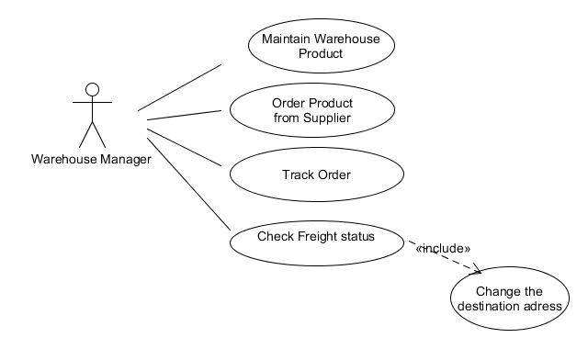
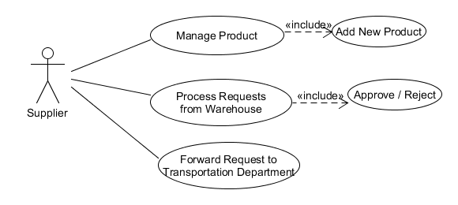
Use Case Diagrams
Warehouse Use Case:
Supplier Use case:

Slide 18
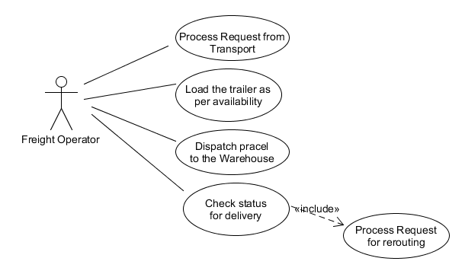
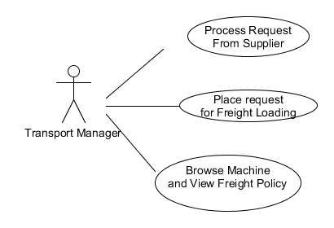
Use Case Diagrams
Freight Use Case
Transport Use Case

Slide 19
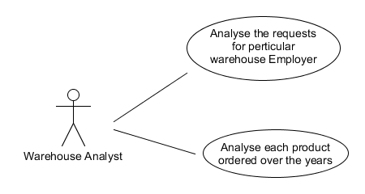
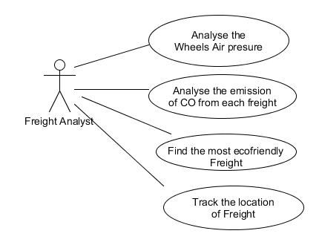
Use Case Diagrams
Warehouse analyst
Freight Data Analyst

Slide 20
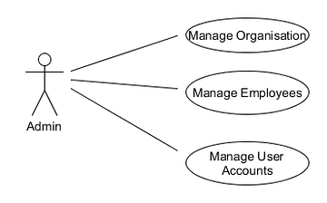
Use Case Diagrams
Admin Use case

Slide 21
References:
->http://info.plslogistics.com/blog/topic/transportation
->http://info.plslogistics.com/blog/how-iot-willcompletely-change-supply-chain
->https://www.quora.com/I-want-to-make-a-project-on-the-IoT-Internet-of-Things-How-do-I-start
http://www.mkyong.com/java/javamail-api-sending-email-via-gmail-smtp-example/
->http://www.emeraldinsight.com/doi/abs/10.1108/SCM-03-2014-0108?journalCode=scm
https://docs.oracle.com/javase/tutorial/2d/
Tutorials on Jfree chart you tube

Slide 22
Thank you

